Slide 1
Lecture-2: Recurrent Problems
The Tower of Hanoi
Lines in the Plane
The Josephus Problem

Slide 2

Recursion is the concept of well-defined self-reference. We use recursion frequently; consider, for example, the following hypothetical definition of a Muslim.
Somebody is a Muslim if she is Karim's wife Amina, or if his or her mother is a Muslim.
So if I want to know if I am a Muslim, I look at this definition. I'm not Amina, so I need to know whether my mother is a Muslim. How do I know about my mother? We look at the definition again. She isn't Amina either, so we ask about her mother. We keep going back through the generations - recursively.
Self-referential definitions can be dangerous if we're not careful to avoid circularity.

Slide 3

We can write pseudo code to determine whether somebody is a Muslim:
FUNCTION isAMuslim(person):
IF person is Karim's wife Amina, THEN:
return true
ELSE:
return isAMuslim(person's mother)
END IF
This is a recursive function, since it uses itself to compute its own value.

Slide 4

The Tower of Hanoi (also called the Tower of Brahma or Lucas' Tower, and sometimes pluralised) is a mathematical game or puzzle. It consists of three rods, and a number of disks of different sizes which can slide onto any rod. The puzzle starts with the disks in a neat stack in ascending order of size on one rod, the smallest at the top, thus making a conical shape.

Slide 5

The objective of the puzzle is to move the entire stack to another rod, obeying the following rules:
Only one disk may be moved at a time.
Each move consists of taking the upper disk from one of the rods and sliding it onto another rod, on top of the other disks that may already be present on that rod.
No disk may be placed on top of a smaller disk.
With three disks, the puzzle can be solved in seven moves.

Slide 6
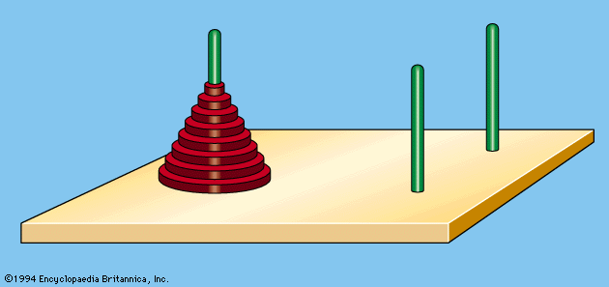
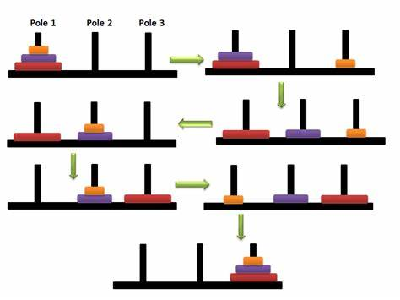

Slide 7

Origins
The puzzle was first publicized in the West by the French mathematician Édouard Lucas in 1883. There is a history about an Indian temple in Kashi Vihswanath which contains a large room with three time-worn posts in it surrounded by 64 golden disks. Brahmin priests, acting out the command of an ancient prophecy, have been moving these disks, in accordance with the immutable rules of the Brahma, since that time. The puzzle is therefore also known as the Tower of Brahma puzzle. According to the legend, when the last move of the puzzle will be completed, the world will end

Slide 8
If the legend were true, and if the priests were able to move disks at a rate of one per second, using the smallest number of moves, it would take them 2⁶⁴−1 seconds or roughly 585 billion years or 18,446,744,073,709,551,615 turns to finish, much longer than the predicted lifespan of the sun. For Instance if the priest turns one disc in 1 second, then it will take 2^64-1 seconds i.e 58x10^12 years. This is five times more than the current estimated age of our universe.

Slide 9

A key to solving this puzzle is to recognize that it can be solved by breaking the problem down into a collection of smaller problems and further breaking those problems down into even smaller problems until a solution is reached. The following procedure demonstrates this approach.
label the pegs A, B, C—these labels may move at different steps
let n be the total number of discs
number the discs from 1 (smallest, topmost) to n (largest, bottommost)

Slide 10

To move n discs from peg A to peg C:
move n−1 discs from A to B. This leaves disc n alone on peg A
move disc n from A to C
move n−1 discs from B to C so they sit on disc n

Slide 11

i.e.
We first transfer the n-1 smallest to a different peg (requiring Tn-1 moves) then move the largest (requiring 1 move), and finally transfer the n-1 smallest back onto the largest (requiring another Tn-1 moves). Thus we can transfer n disks(for n>0) in at most 2Tn-1 +1moves:
Tn=0, for n=0
Tn = 2Tn-1 +1, for n>0

Slide 12

So we can compute, successively,
T3 =2.3+1=7;
T4 =2.7+1=15;
T5 = 2.15+1=31;
It looks as if
Tn = 2^n-1; for n>0
Just check!

Slide 13

By mathematical induction we can prove that
Tn = 2Tn-1 +1=2^n -1
How? Try to remember…
Mathematical induction….

Slide 14

Replace n by n-1

Slide 15

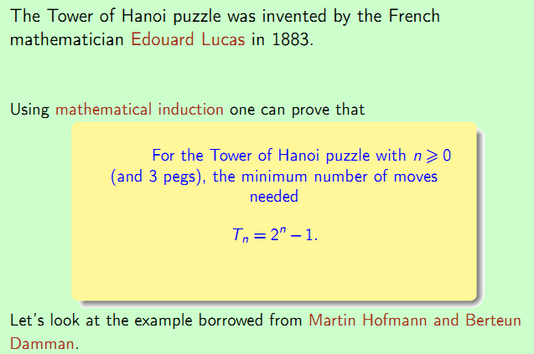


Slide 16

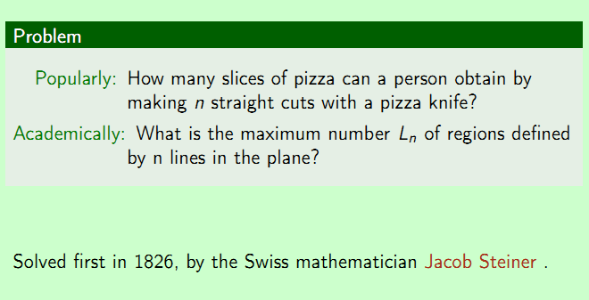

Slide 17


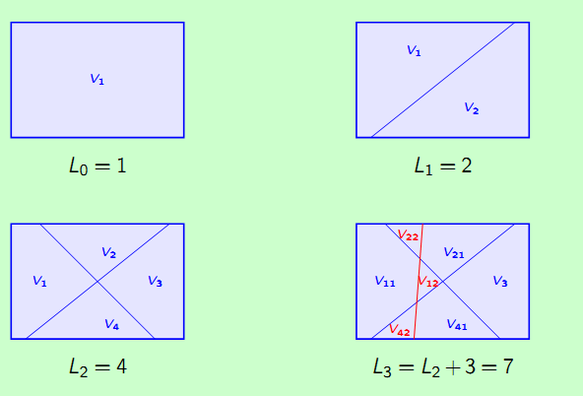

Slide 18

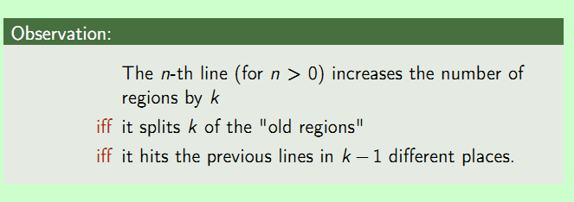
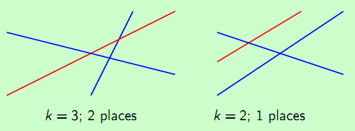

Slide 19
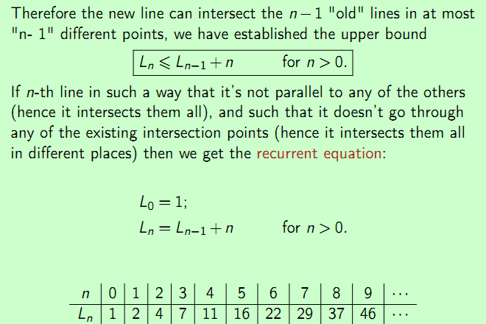

Slide 20
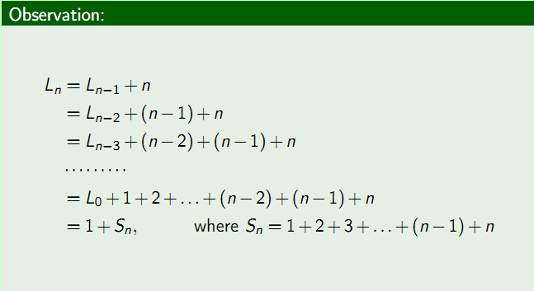


Slide 21
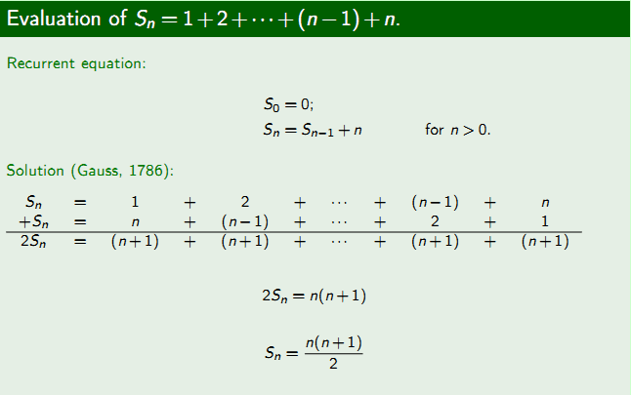

Slide 22
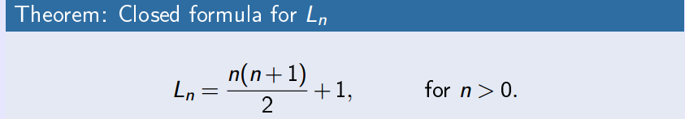
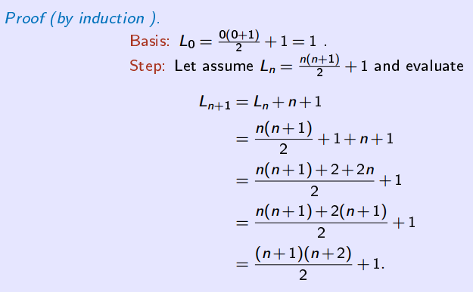

Mathematical proof by induction

Slide 23
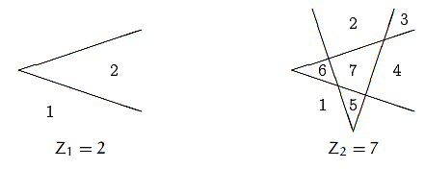
Home Task
What about these types of lines?
What about the lines that are parallel and may intersect to the existing points?
Can you find recursive solution of these two?

